Slide 1

Forecasting, Design, Development
Max Aronheim

Slide 2

MISSION STATEMENT
To introduce models & frameworks that are used to simplify big business problems
Ultimately to streamline the product development pipeline
—
Prod Dev 1 – Streamlining internal, cultural operations: Teamwork
Prod Dev II – Streamlining the technical process. Guided under the stage gate process

Slide 3

Overview
Full Application of the stage gate process
Stage Gate Process – Recap phase 1 & 2 using models & frameworks
Evaluation phase. Feasibility approaches
Development & distribution – Key considerations
Grocery Grades
Case Study Application
Take Home Case Assignment

Slide 4
Stage Gate Recap
Firm & Market
Idea Generate
Evaluate
Develop
Deploy

Slide 5
External Analysis
Phase 1: Firm & the Market
This helps us to answer
What are the boundaries we should work in when coming up with new products
Ie. A tech company prob wouldn’t make a food product
Internal Analysis
SWOT
VRIO (competitive strengths)
Market Sizing
Market Share
Porter’s 5 Forces

Slide 6

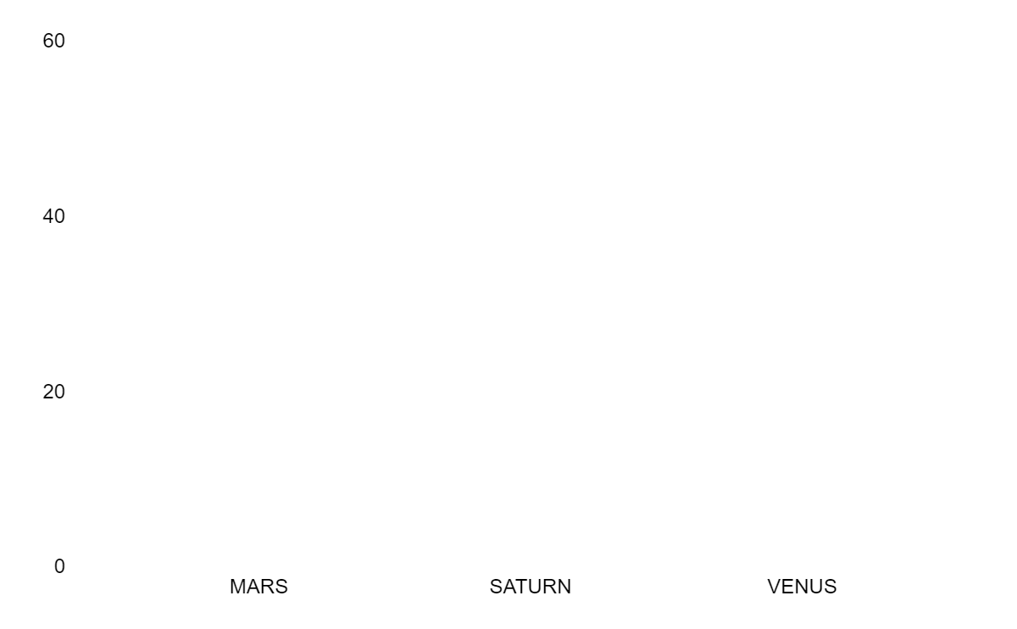
Phase 2: Ideation & Concept Evaluation
Concept Validity
Does this idea make sense within itself. Pain point identified
Market Alignment
Innovation lifecycle
Product adoption
Strategic Alignment
60
10
20
Product mix (BCG)
Concept tests
Consumer reports
Paint point 1
Point Point 2
Pain Point 3
A Need Fulfilment Analysis

Slide 7
01
02
MARKET
STRATEGIC
Phase 3: Feasibility Analysis
03
04
FINANCIAL
TECHNICAL
Is the market good for this?
Does this make sense for the firm?
Do the numbers make sense?
How realistic is it for us to pull it off?

Slide 8
Requirements
Build
Testing
Phase 4: Development
Project Scope
Key Stakeholders
Specs
Utility types
Structured check ins
Functional
Usability
UAT

Slide 9

01
02
03
PRICING
DISTRIBUTION
QUALITY
Phase 5: Deployment
04
05
06
SALESFORCE
BRANDING
4 Ps
You can describe the topic of the section here
Where are we placing the product
Can quality be scaled
How must we adapt based on product phase
What are we conveying
Product
Price
Placement Promotion
Notes:
Make sure to stay on this slide. Ask about the incentives of finance. Then move to the next slide.

Slide 10
Incentives of Finance
More Money
Less Risk
Less Time

Slide 11
FINANCE IS…
Capital Allocation
BUYERS
SELLERS
x
People who need money & will pay a premium
Valuation
—
How much is something worth at some point in time?
People who will lend money for a higher price

Slide 12
FINANCE CONCEPTS
SAMPLE BUSINESS
TACO BUSINESS:
$3 tacos
$1.50 to make
$3k/month to rent taco truck
CM components
Breakeven
Sales Forecasting

Slide 13
Contribution Margin
& Break Even Anal.
CM
Breakeven
CM = Price - Cost
On a per unit basis
For every taco you sell, how much (the ‘margin’) goes back to the business
BEP = FC / CM
How many tacos do you need to sell to pay off that taco truck rent

Slide 14
Recall Clicker Question
Total Variable Cost is Unit Variable Cost times ________?
Sales
Fixed Cost
Quantity
Price

Slide 15
Sales Forecasting Strategies
TOP DOWN
Measure the market & our share
MERGED
Product FInancial Viability
Combine both methods to estimate sales
BOTTOM UP
Determine unit sales & scale to revenue

Slide 16
TOP DOWN
SUPPOSE…
Bottom Up
Sales Forecasting Sample
Market size: $1.2B
Market Share: 2%
g = 5%
Price = $1.50
Cost = $0.75
∴ Rev = $1.2B * 2% = $24M
Bev co. want a geographic expansion.
They want to estimate the value of an expansion like this
1200 stores
Price = $1.5
Q = 500/store
G = 10%
∴ Rev = 1200 * 500 * $1.5 = $900k

Slide 17
ASSUMPTIONS BASED
Finding Forecast Assumptions
REFERENCE BASED
uses historical data or a comparable company to base your assumptions
very hard to find a truly comparable company
use quantitative math to determine assumptions that you use for forecasting.
Most common!

Slide 18
CONSUMER
PRODUCT
COMPETITION
Extra FInancial Considerations
EXTERNAL
TRENDS
NEWNESS
How receptive are they to a product
What's the product performance?
Is the product defensive? VRIO
Weather, Covid, etc.
ESG. Diversity. Is your product considerate?
How new is is to consumers

Slide 19
RESEARCH
VRIO
Methods for Forecast Accuracy
ASSUMPTIONS
DISTRIBUTION
Consumer surveys
Building our strategic defenses
In-Market Tests
Build Push & pull relations

Slide 20
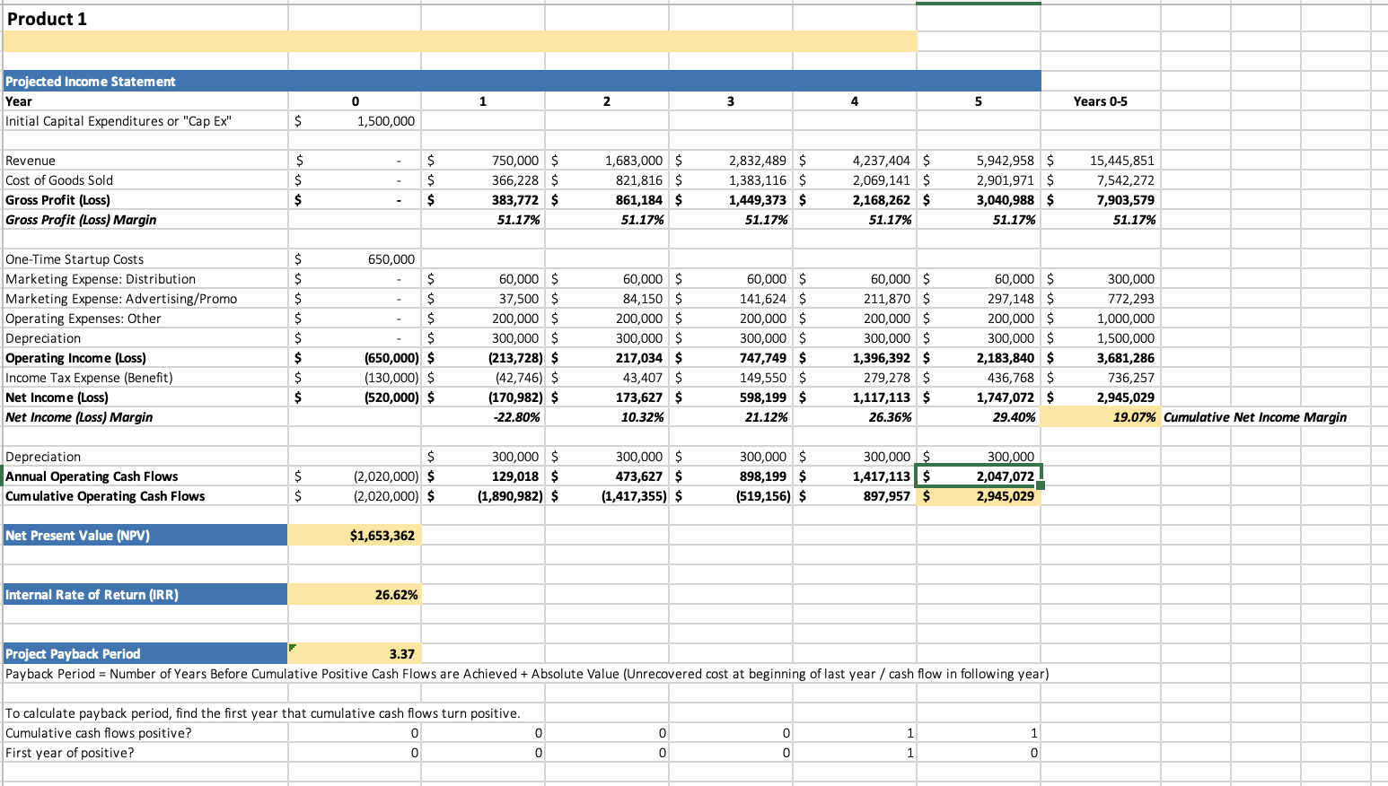
Notes:
Luckily for you, you only need to figure it out for year 1.

Slide 21
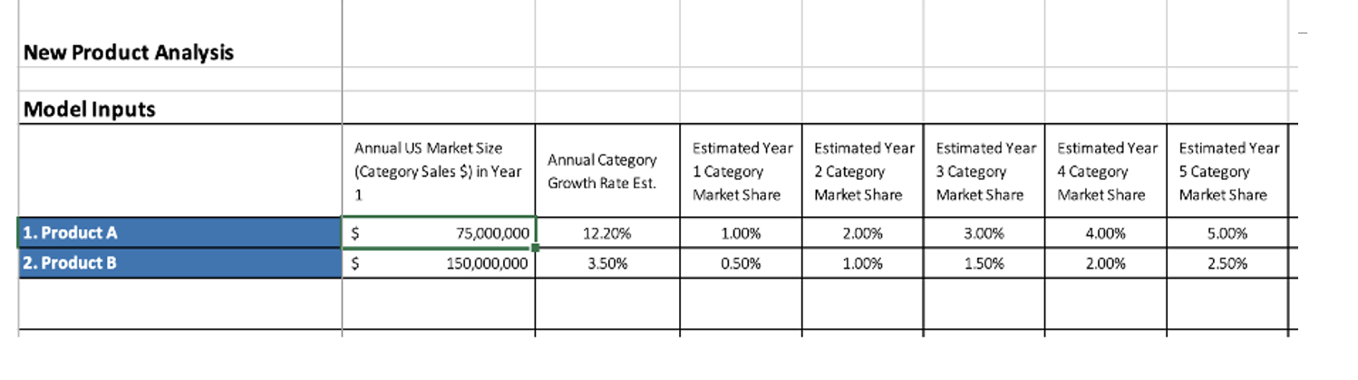
The Project Sales Forecast
Notes:
Luckily for you, you only need to figure it out for year 1.

Slide 22
Phase 4: Development
Innovation models
Package design
Functional Specs
User Guide

Slide 23

Yves Behar Ted Talk Designing Objects that Tell Stories | User-Oriented Design
“I wanted to work, not just on the skins, but on the entire human experience” – Yves Behar
“As designers, we need to think about how we can create a different relationship between our work and the world” – Yves Behar
“Design is the glue that brings [these values] together.” – Yves Behar

Slide 24
Types of Design
User-Oriented
Benefit Oriented
What do users need
What do you get from having it?
Ergonomic
Visual Brand
Human Interaction (ie. mouse shapes)
Nike vs Paul Gaultier
70%
30%
FEMALE
MALE
Notes:
Biggest consideration is how does that relate to your target market. For example, kylie jenner lip kit is gonna be prob all women, but Rihanna-Asap rocky lip balm might look more like this.

Slide 25
Requirements
Build
Testing
Phase 4: Development
Project Scope
Key Stakeholders
Specs
Utility types
Design types
Functional specs
User reqs.
Product specs
Functional
Usability
UAT

Slide 26
FUNCTIONAL REQUIREMENTS
USER REQUIREMENTS
Self Cleaning – Allows user to clean the grill area without manual effort by simply switching one button. The grill must be clean with no food residue when in the clean state.
Works Off Propane or Gas – The user will be able to fuel their grill with either portable propane tanks or with connection to a natural gas outlet. The ability to switch between the two sources can be accomplished without tools and will take less than three minutes.
Short Depth Design – A standard grill is 28 inches deep (from front to back). This grill will at least 20% more shallow than a standard grill.
Suppose we’re making an oven
Self Cleaning
Uses propane
Uses little amount of space

Slide 27
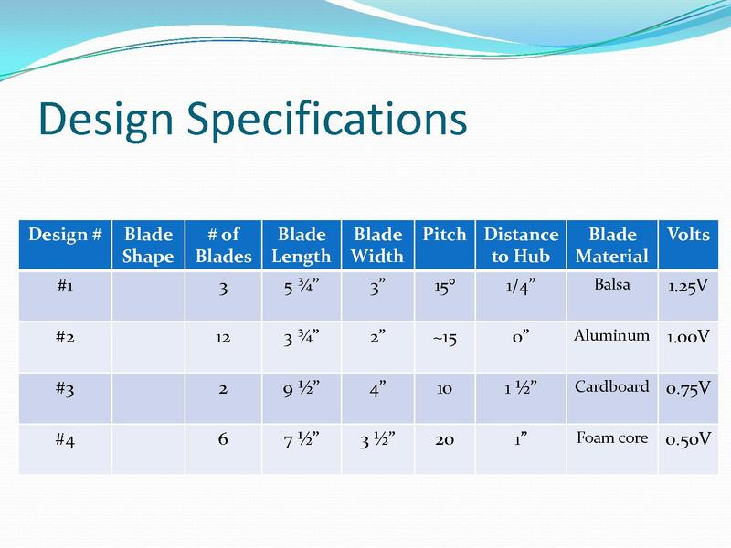

Slide 28
TESTING FOR NEW PRODUCT DEV.
 | PROTOTYPE | PRODUCT USE | MARKET TESTING
PRODUCT STATUS | Unfinished | Almost Done | Finished product
GOALS | Refine Go/No-go checkpoint Refine packaging | Final changes Go/No-go Pricing positioning | Distribution Pricing Packaging Finalize forecasts

Slide 29
01
02
03
4 Ps
CYCLES
INNOVATION TYPE
Phase 5: Deployment
04
05
DISTRIBUTION
UTILITY
Product
Price
Placement Promotion
Prod. adoption
Newness to market
Newness to customer
Continuous
Dynamically continuous
discontinuous
Distribution intensity
What are we conveying

Slide 30
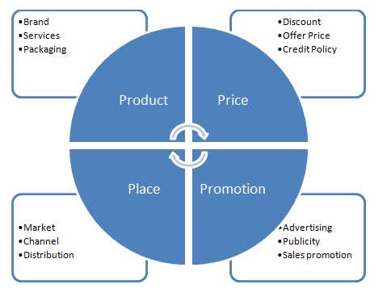
4Ps Thesis
is our product in the right time, the right place, and in the right form?
If so, we’ve created utility!
All of it should relate back to consumers (STP)

Slide 31
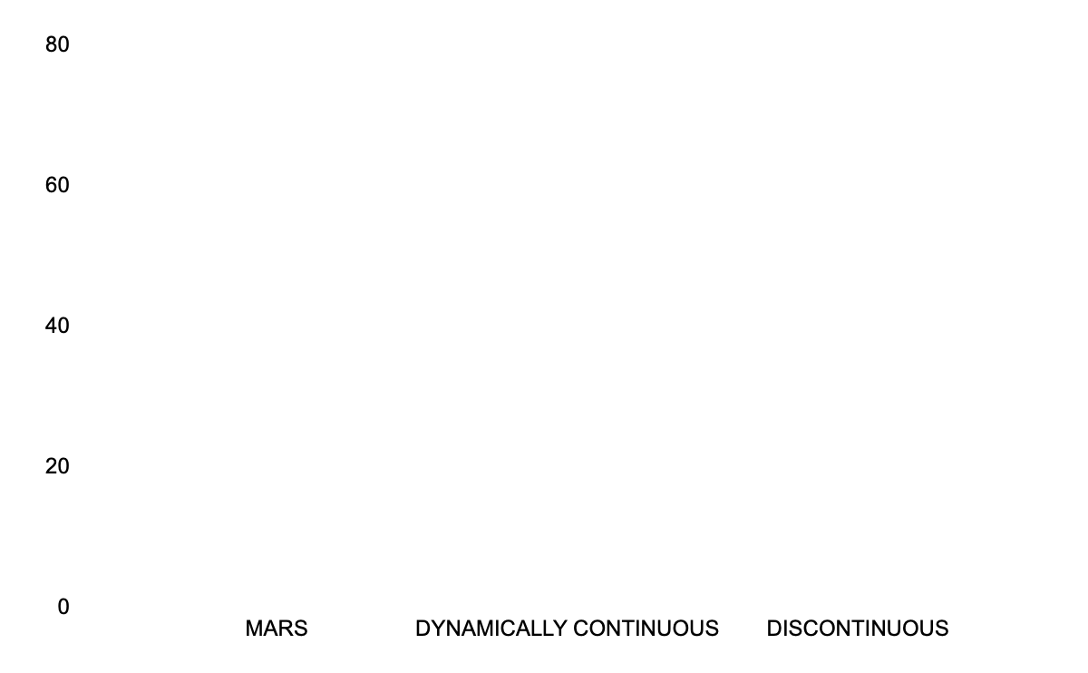
Newness to Customer
CONTINUOUS
Minor improvements to existing products
DYNAMICALLY CONTINUOUS
Moderate changes to consumer behaviors
DISCONTINUOUS
75%
50%
15%
Very new products that create very new consumer behavior
60
10
20
CONT.
DYN.
DISC.
Notes:
This matters for 2 big reasons. Sales for the product, the marketing required for consumers to adopt this product, the cost of borrowing money. Riskier projects must have higher compensations, and so firms must because extra restrictive witht he Go/No-go part of stop gate.

Slide 32
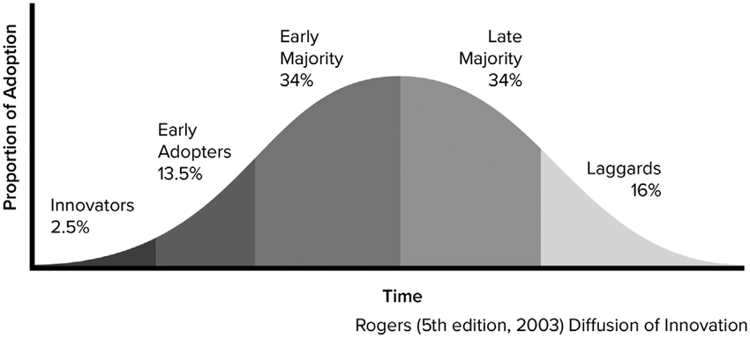
INNOVATION ADOPTION LIFECYCLE

Slide 33
DISTRIBUTION STRATEGIES
INTENSIVE
SELECTIVE
EXCLUSIVE
Everywhere
Ie. So like food
A few places
Ie. So like computers
One place
Ie. Designer stores
Notes:
All of it really depends on the buyer requirements & firm to market fit. Considerations would include info, convenience, service quality

Slide 34
01
02
03
FORM
POSSESSION
TIME
VALUE: UTILITY TYPES
04
05
PLACE
SERVICE
Functional value.
Ie. Customizable shoes or clothing
Ease to acquire
Ie. Square payments
Ie. flexible payment
plans
Saving time
Ie. Fast shipping options
Convenience
Ie. Vending machines in high-traffic areas
What are we conveying
Notes:
What are the big types of value

Slide 35
GROCERY GRADES
Research Paper Style Writing
ANALYSIS WITHOUT FRAMEWORKS
SOLUTION
Introduce BLOT
Framework Application
Notes:
All of it really depends on the buyer requirements & firm to market fit. Considerations would include info, convenience, service quality

Slide 36
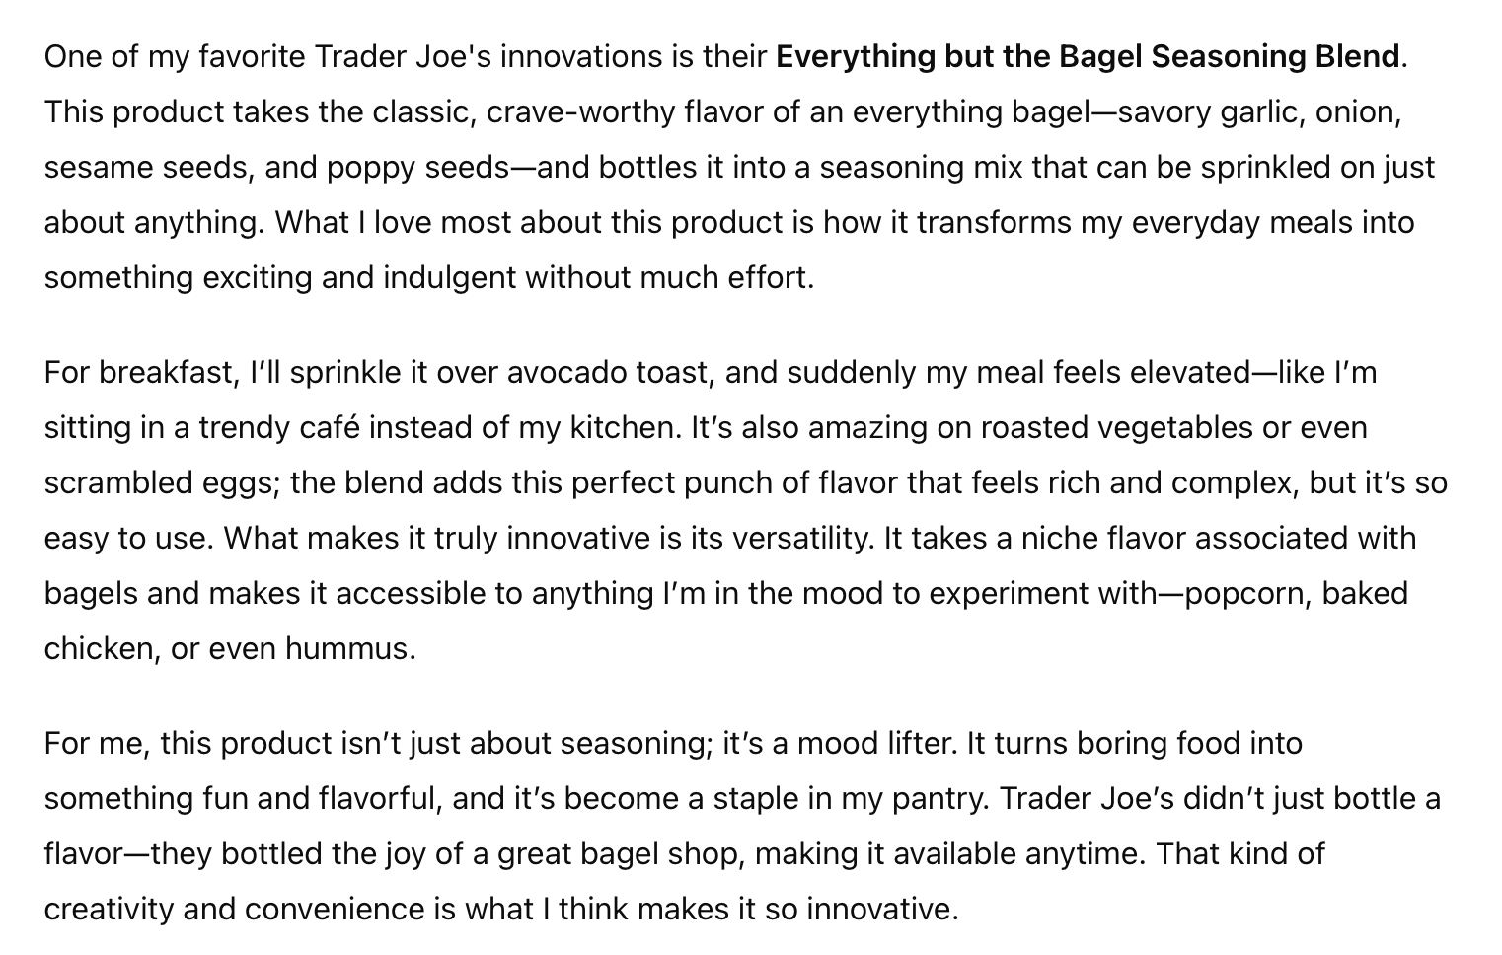
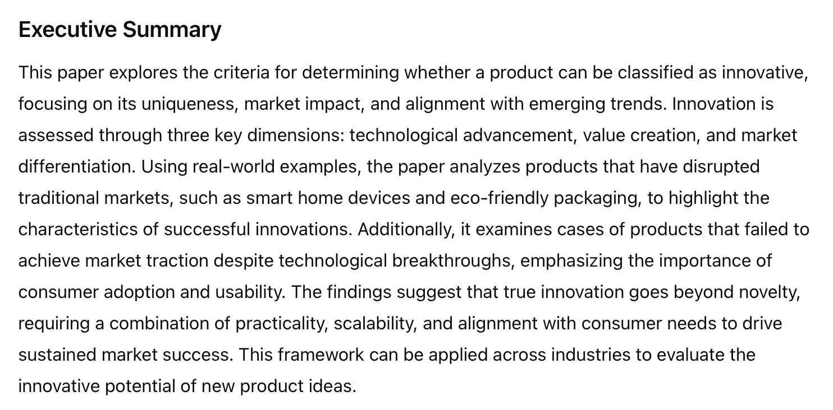
Bad Practice Examples

Slide 37
BLOT – Bottom Line On Top
NOT BLOT
BLOT
"Our company has been evaluating various software options to enhance productivity, streamline our processes, and reduce costs. After assessing multiple vendors and conducting a series of trials, we have decided to implement WorkSuite Pro as it meets our needs effectively."
Achieved X
Measured by Y
For Z Reason
We implemented WorkSuite Pro
—
To enhance productivity and reduce costs

Slide 38
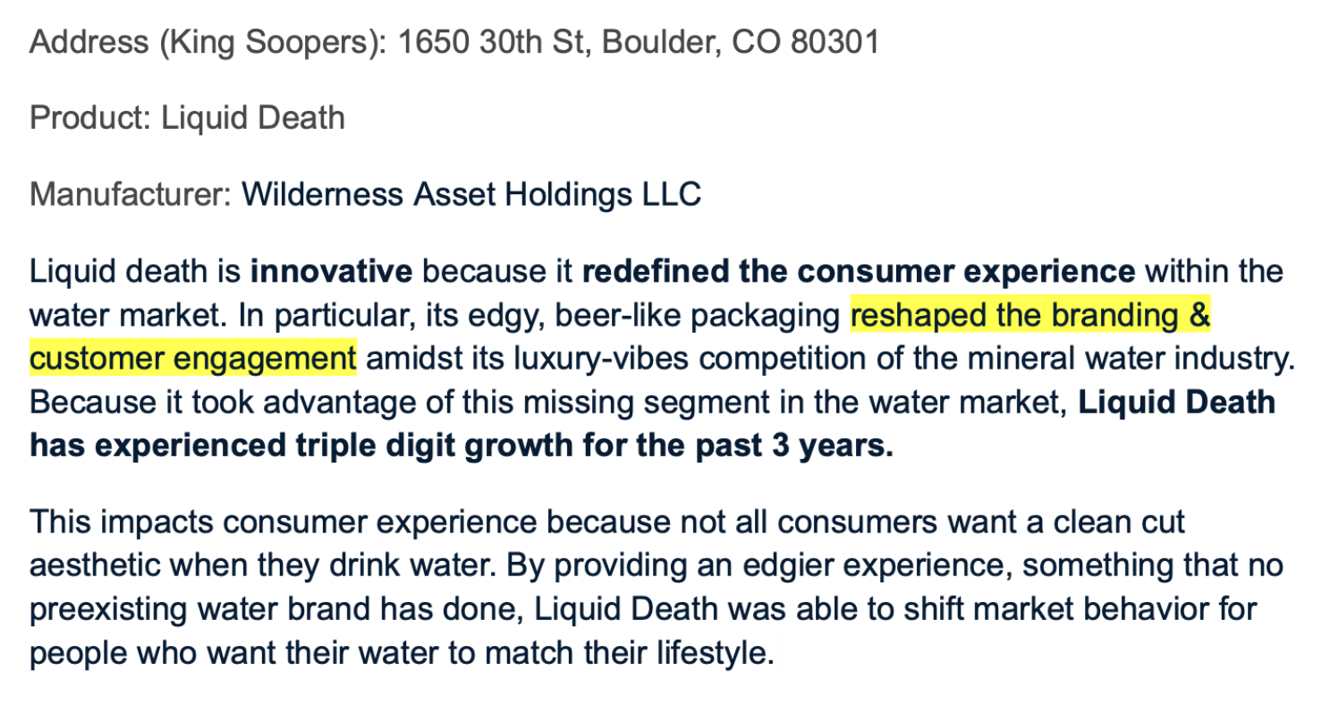

Slide 39

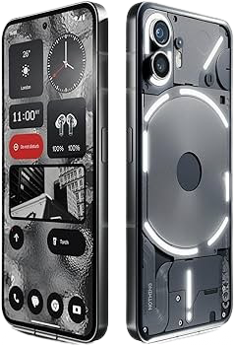
LET’S NOW APPLY EVERYTHING
Firm: Nothing Phone
A successful low cost provider for mobile phones.
This is incredibly impressive because the mobile phone market is uber saturated with competitors. So, how did they do it? To help break this down I’m going to walk everyone through the 3 frameworks that you’ll be using for the take-home case report.
Porter’s 5 Forces
SWOT
Product Adoption Lifecycle

Slide 40
EXTERNAL ANALYSIS: PORTER’S 5 FORCES
SUPPLIER
BUYERS
EXISTING RIVALS
SUBS
NEW ENTRANT
MOD-HIGH
HIGH
HIGH
LOW
MODERATE
Semiconductors are produced by a few
Low switching cost, lots of competition
Big competitors, price wars
Few replacements
High CapX
Open to niches

Slide 41
INTERNAL ANALYSIS: SWOT
S
W
O
T
Premium features, affordable cost
Eco-friendly
Innovative phone back
New entrant
Small product ecosystem
Supply chain dependence
Limited marketing & distribution channels
Niche market (tech enthusiasts)
Growing demand for value phones
ESG
Joint ventures
Expanded product ecosystem
Intense competition
Saturated market
Market (economy)
Phones are a discretionary item
VR(I)O
imitable

Slide 42
Deduction
The Nothing Phone captures a niche market of innovators that are focused on differentiated value rather than name recognition.
This aligns with the rising demand for value phones amidst high price brand name phones.
They do so with their premium features for affordable prices.

Slide 43
Take Home Case: Goals
Effectively apply 3 strategic frameworks & their insights
Deduce what a firm’s next steps should be based on that information
Identify the key risks and concerns that a business should be looking out for when pursuing a new product
Most importantly, being selective about what information is conveyed
To the point where if you take out any sentence, you would lose points for not meeting the rubric

Slide 44
USING YOUR OWN FORMAT
BRAIN BARF
NOT BEING SELECTIVE
3 RED Herrings
AI can identify things but isn’t the best at insight & refining delivery
Content that doesn’t intentionally guide the discussion. Everything should lead to a suggestion.
There are 170 students to grade. That’s like 600 pgs. Let’s not take risks
Identify the products that could work, the ones with priority in BLOT
Notes:
For brain barf, listing risk & mitigation for each product rather than the ones we recommended. Being selective would mean addressing that firms have limited resources. So identify all the ones that could be successful based on BCG, and then provide a priority for the two main ones presented in BLOT.

Slide 45
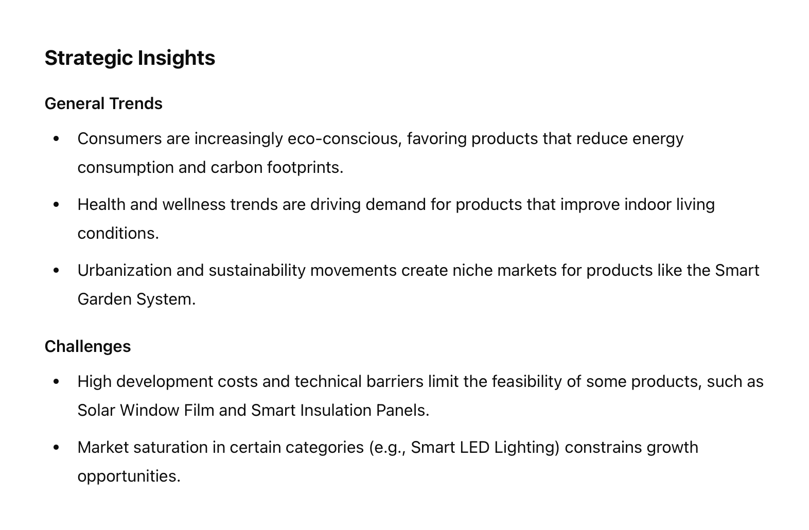
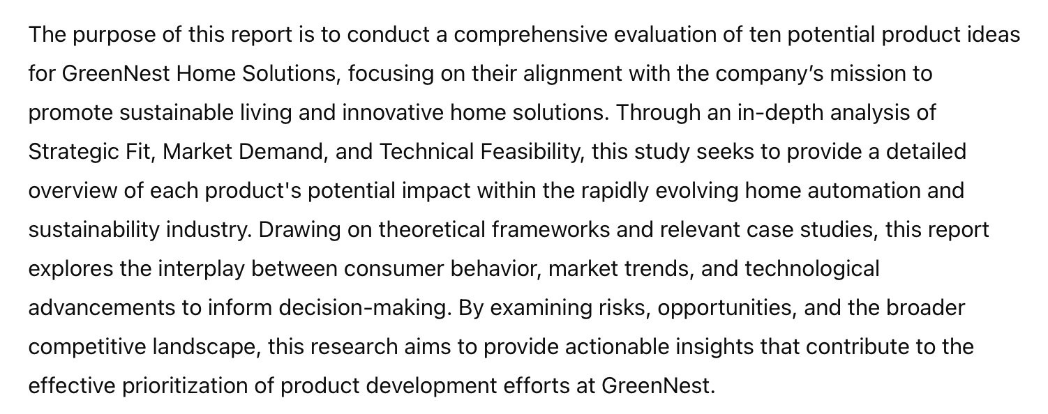
Bad Practice Examples

Slide 46
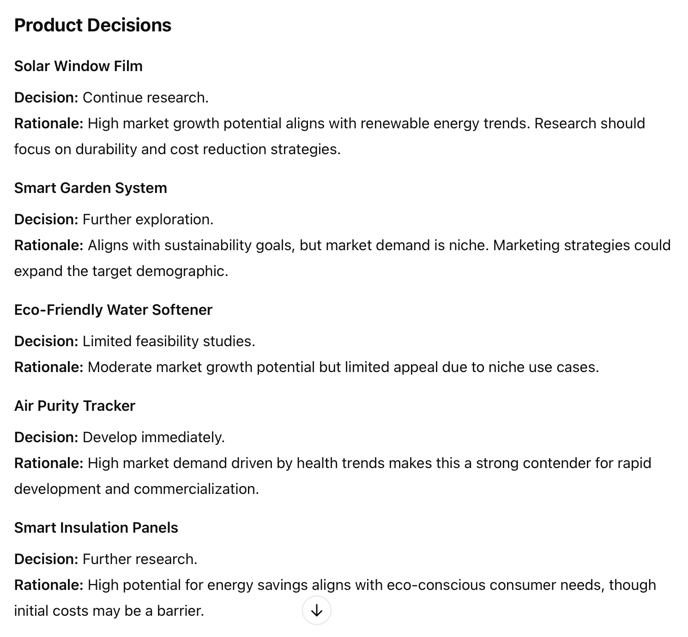
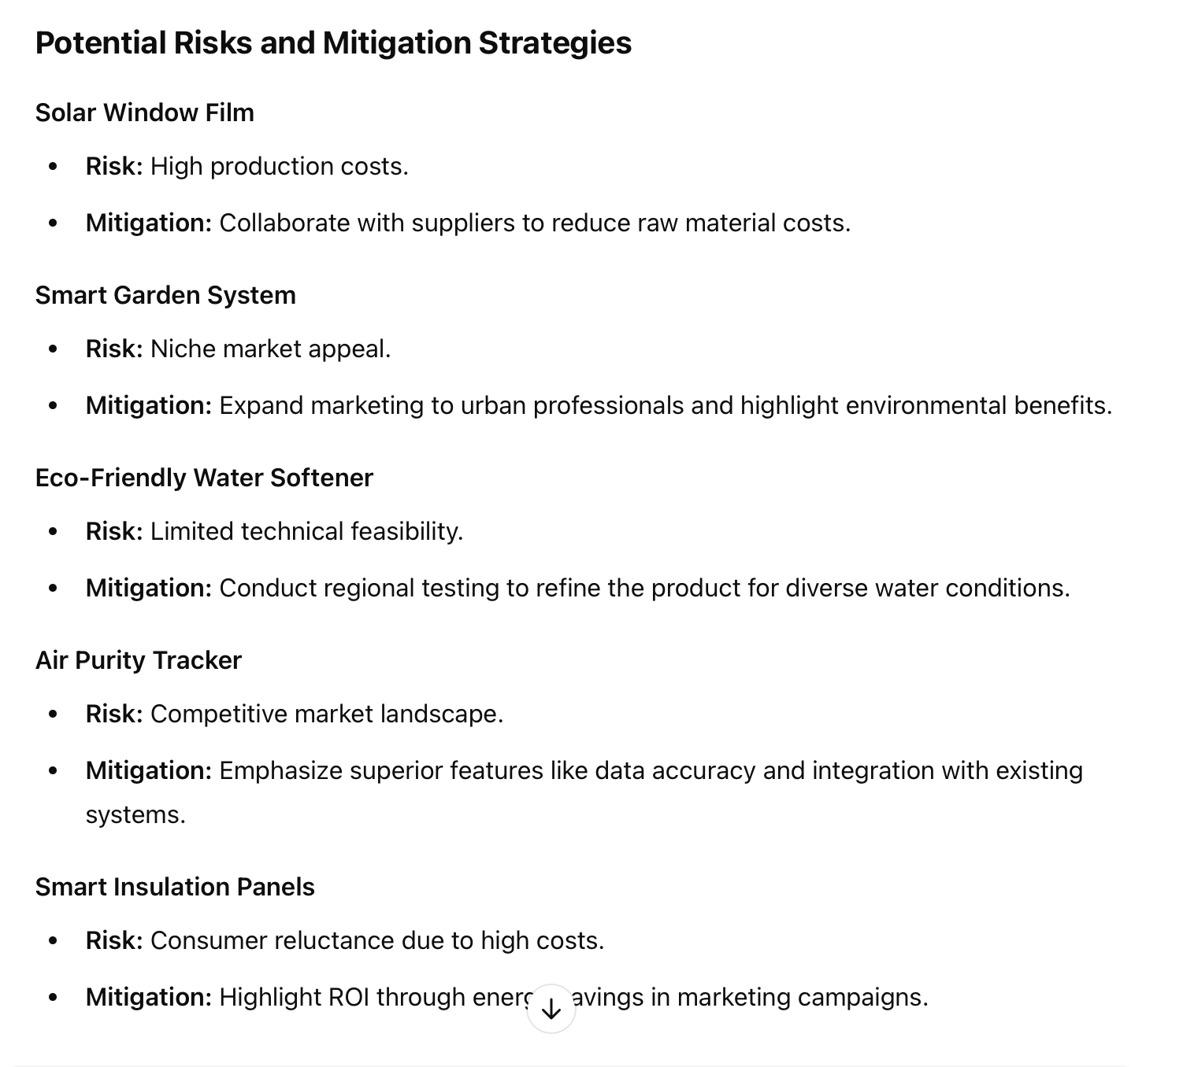
Bad Practice Examples
Notes:
Make sure to tail back to the SWOT & Porter’s 5 Forces pptx to tell them to literally use what i’ve given & find a way to translate it to a report?

